Slide 1



The Potential of Football Transfer Valuations

Slide 2
Problem Statement and Proposed Solution
Problem: In the intricate world of football, providing clubs with accurate player valuations poses challenges. I aim to combat this through predictive modelling by leveraging statistical analysis, machine learning algorithms, and comprehensive data-sets.
Solution: I aim to address this challenge through predictive modelling, utilizing advanced statistical analysis, machine learning algorithms, and comprehensive datasets.
Impact: By bringing objectivity and accuracy to player valuations, this approach has the potential to revolutionize player acquisitions, inform contract negotiations, and enhance player career management in the transfer market.

Slide 3
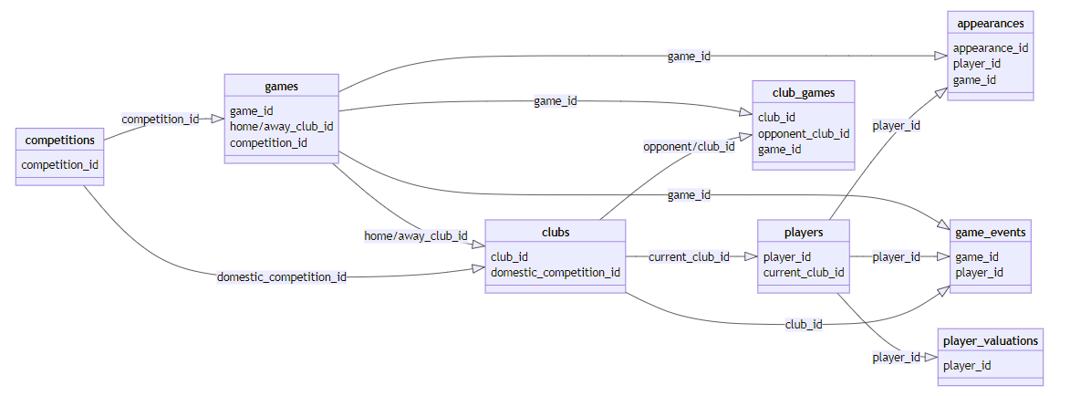
Dataset Overview
Dataset Significance:
My dataset, sourced from "Kaggle" and "Transfermarkt.com" Data, is a comprehensive collection of information on player transfers, market values, and historical data.
Advanced Preprocessing:
Building on Sprint 1, I implemented advanced preprocessing techniques to address specific challenges, ensuring the dataset is ready for modeling.
I split my dataset into a training, validating and testing set.
I scaled all my data preventing certain features from overshadowing others due to their sizes.
I encoded all my data into numerical form so that it could be processed by the model.

Slide 4
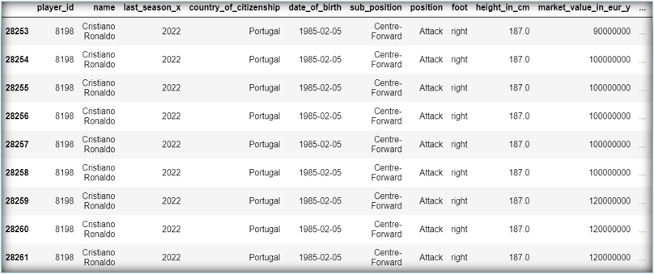
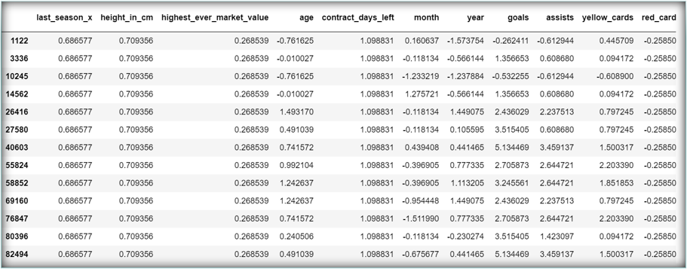
Before Pre-Processing:
After Pre-Processing:

Slide 5
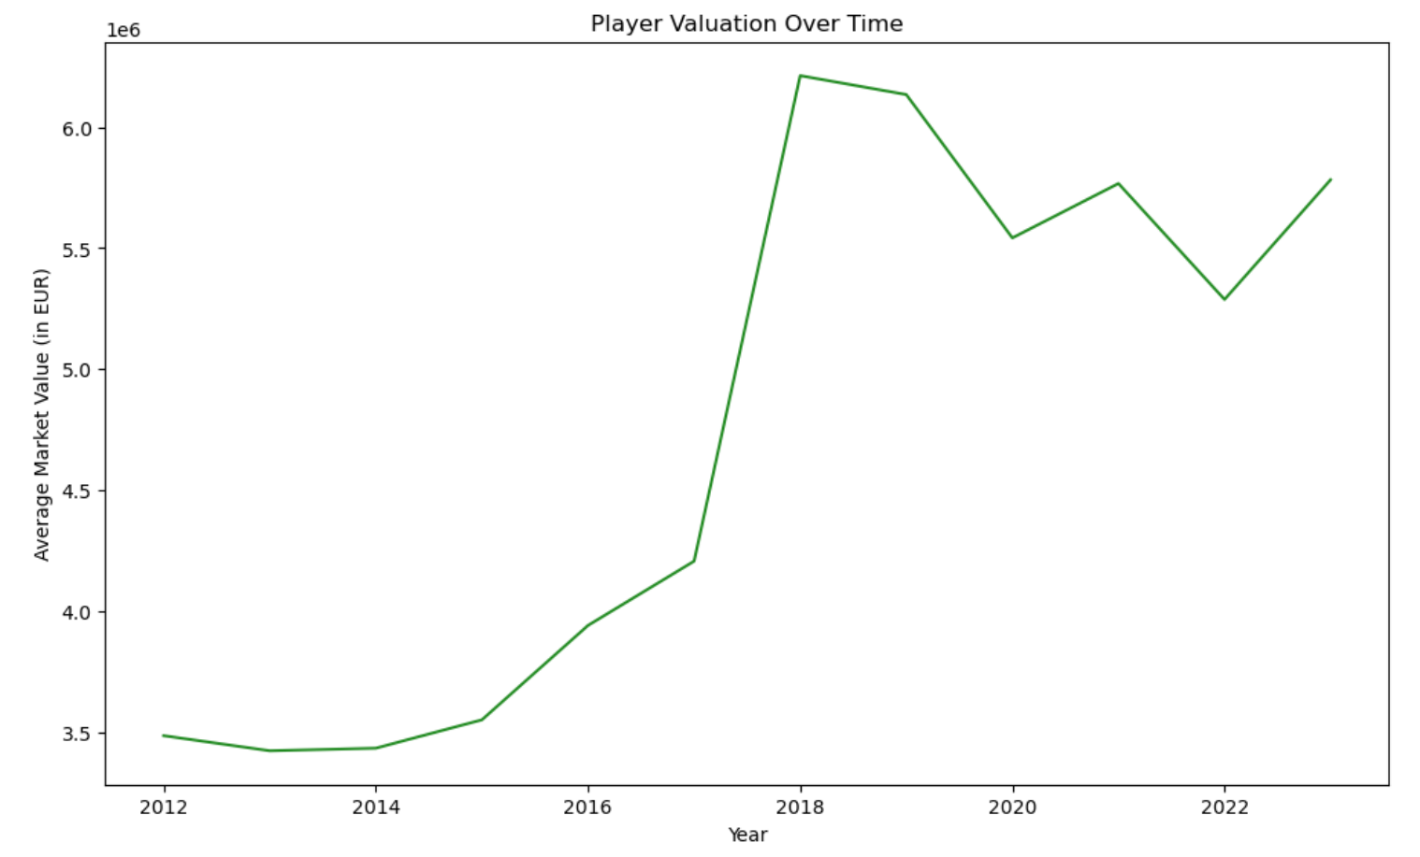
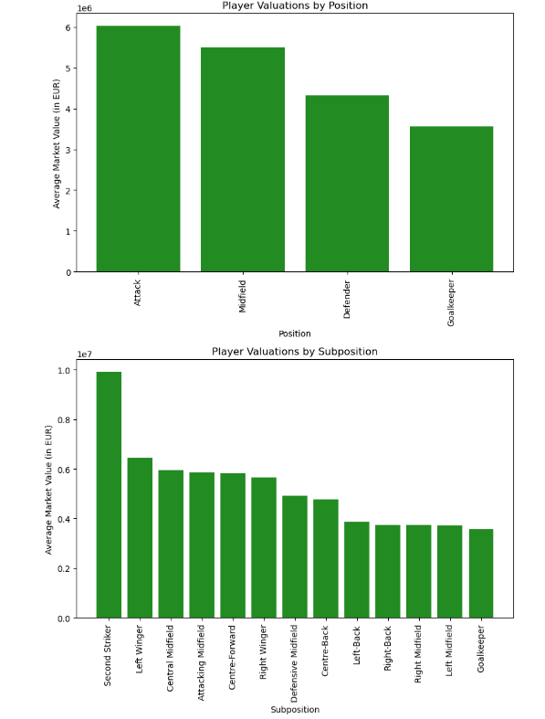
A Few Pre-Modelling Insights
z

Slide 6
Baseline Modelling and Evaluation Framework
To set the stage for advanced modelling in sprint 3, we created baseline machine learning models in Sprint 2.
Linear Regression:
For my initial baseline model, I set up a Linear Regression model which had an initial R-Squared score (How well our model explains the patterns in the data) of 70% on the training data and validation data which is relatively decent in of itself.
Decision Tree Regression:
For my second, more advanced model I ran a Decision Tree Regression model through a Cross-Validated grid-search with optimized hyper-parameters.
For this final optimized model, I got a train score of 0.89% and a validation score of 0.84% which is a really good improvement on the Linear Regression model.

Slide 7
Next Steps
Next Actions:
Feature Optimization:
Exploring opportunities for feature improvement to enhance predictions.
Advanced Modelling:
Transitioning to advanced machine learning techniques such as Ensemble Learning or Neural Networks.

